Slide 1

Environments vs Virtualization vs Containerization
App1
Bins/lib
OS
VM
App2
Bins/lib
OS
VM
App3
Bins/lib
OS
VM
App1
Bins/lib
Container
App2
Bins/lib
Container
App3
Bins/lib
Container
App1
Libs
Venv
App2
Libs
Venv
App3
Libs
Venv
App3
Bins/lib
Container
App2
Bins/lib
Container
App3
Bins/lib
Container
Python
Hypervisor
Docker
Operating System
Operating System
Operating System
Infrastructure
Infrastructure
Infrastructure
Virtual Environments
Virtualization
Containerization
7

Slide 2
Virtual Environments
Pros
Reproducible research
Explicit dependencies
Improved engineering collaboration
Cons
Difficulty setting up your environment
Not isolation
Does not always work across different OS

Slide 3
Virtual Machines
Pros
Full autonomy
Very secure
Lower costs
Used by all Cloud providers for on demand server instances
Cons
Uses hardware in local machine
Not very portable since size of VMs are large
There is an overhead associated with virtual machines

Slide 4
Wish List
We want a system that:
Automatically set up (installs) all OS and extra libraries and set up the python environment
It is isolated
Uses less resources
Startups quickly
Containers

Slide 5
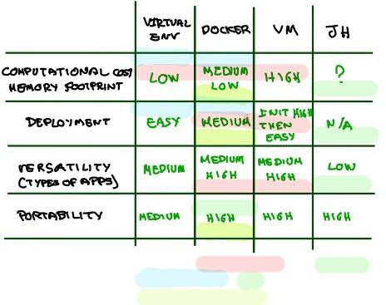
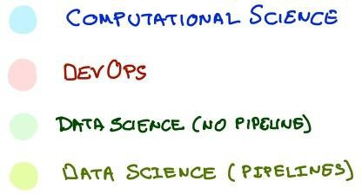
Comparison
49

Slide 6
What is a Container
Container
Container
Container
Standardized packaging for software dependencies
Isolate apps from each other
Works for all major Linux distributions, MacOS, Windows
Tomcat
SQL Server
Java
.Net
Static Binary
Debian
Ubuntu
Alpine
Docker
Kernel

Slide 7

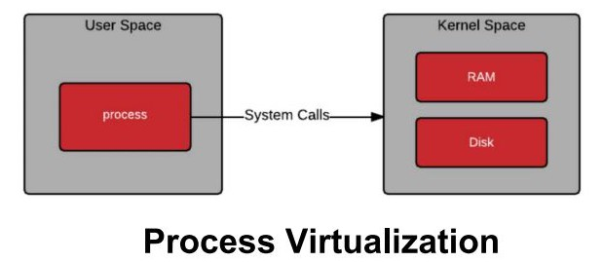
What Makes Containers so Small?
Container = User Space of OS
User space refers to all of the code in an operating system that lives outside of the kernel

Slide 8
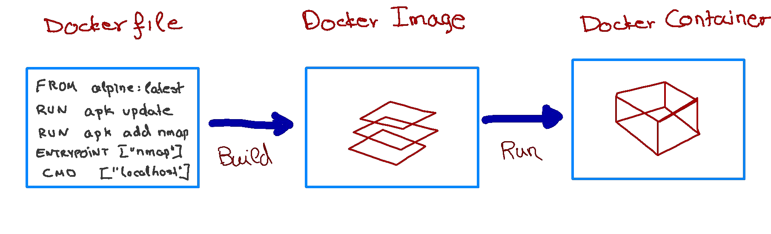
How to run a docker container
We use a simple text file, the Dockerfile, to build the
Docker Image, which consists of an iso file and other files.
We run the Docker Image to get Docker Container.

Slide 9
What is the difference between an image and container
Docker Image is a template aka a blueprint to create a running Docker container. Docker uses the information available in the Image to create (run) a container.
Image is like a recipe, container is like a dish.
Alternatively, you can think of an image as a class and a container is an instance of that class.

Slide 10
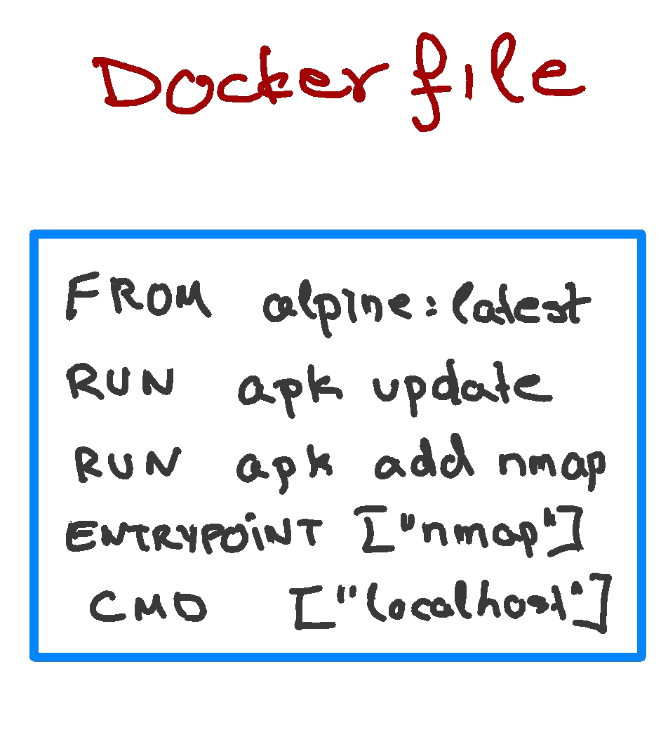
Inside the Dockerfile
FROM: This instruction in the Dockerfile tells the daemon, which base image to use while creating our new Docker image. In the example here, we are using a very minimal OS image called alpine (just 5 MB of size). You can also replace it with Ubuntu, Fedora, Debian or any other OS image.
RUN: This command instructs the Docker daemon to run the given commands as it is while creating the image. A Dockerfile can have multiple RUN commands, each of these RUN commands create a new layer in the image.
ENTRYPOINT: The ENTRYPOINT instruction is used when you would like your container to run the same executable every time. Usually, ENTRYPOINT is used in scenarios where you want the container to behave exclusively as if it were the executable it's wrapping.
CMD: The CMD sets default commands and/or parameters when a docker container runs. CMD can be overwritten from the command
line via the docker run command.
13

Slide 11
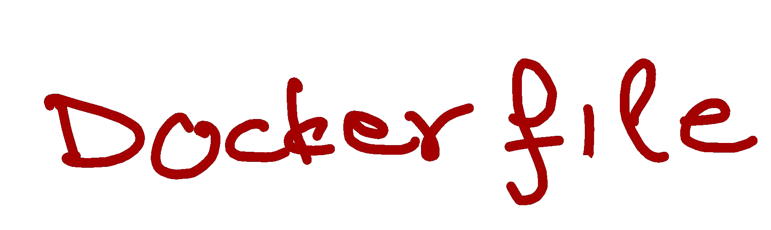
Multiple containers from same image
How can you run multiple containers from the same image?
Yes, you could think of an image as instating a class.
Wouldn’t they all be identical?
Not necessarily. You could instantiate it with different parameters using the CMD and therefore different containers will be different.
docker build -t hello_world_cmd:first -f Dockerfile_cmd .
docker run -it hello_world_cmd:first
Hello world
docker run -it hello_world_cmd:first Pavlos
Hello Pavlos
FROM ubuntu:latest RUN apt-get update
ENTRYPOINT ["/bin/echo", "Hello"] CMD ["world"]

Slide 12
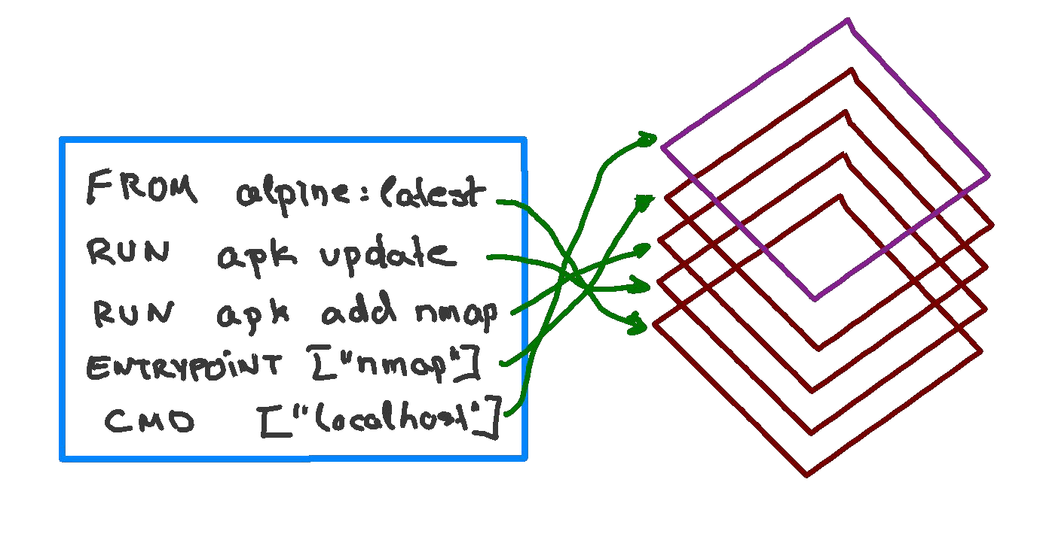

Docker Image as Layers
When we execute the build command, the daemon reads the Dockerfile
and creates a layer for every command.

Slide 13
Image Layering
A application sandbox
Each container is based on an image that holds necessary config data
When you launch a container, a writable layer is added on top of the image
Container
(Writable, running application)
Layered Image 2
A static snapshot of the container configuration
Layer images are read-only
Each image depends on one or more parent images
Layered Image 1
Platform Image
(Runtime Environment)
An Image that has no parent
- Platform images define the runtime environment, packages and utilities necessary for containerized application to run

Slide 14
Image Layering - Example
Docker layers for a container running debian and a python environment using Pipenv
Pipenv Sync
Install Pipenv
Upgrade Pip
Install Python & Pip
Debian Linux
Kernel

Slide 15




Some Docker Vocabulary
Docker Image
The basis of a Docker container. Represent a full application
Images
How you store
your application
Docker Container
The standard unit in which the application service resides and executes
Containers
How you run your application
Docker Engine
Creates, ships and runs Docker containers deployable on a physical or virtual, host locally, in a datacenter or cloud service provider
Registry Service (Docker Hub or Docker Trusted Registry)
Cloud or server-based storage and distribution service for your images

Slide 16


Docker Image as Layers
>docker build -t hello_world_cmd -f Dockerfile_cmd .
Sending build context to Docker daemon Step 1/4 : FROM ubuntu:latest
latest: Pulling from library/ubuntu 54ee1f796a1e: Already exists f7bfea53ad12: Already exists 46d371e02073: Already exists b66c17bbf772: Already exists
34.3kB
Step1: Instruction 1
Digest: sha256:31dfb10d52ce76c5ca0aa19d10b3e6424b830729e32a89a7c6eee2cda2be67a5 Status: Downloaded newer image for ubuntu:latest
---> 4e2eef94cd6b
Step 2/4 : RUN apt-get update
---> Running in e3e1a87e8d6e
Get:1 http://archive.ubuntu.com/ubuntu focal InRelease [265 kB]
Step2: Instruction 2
Get:2 http://security.ubuntu.com/ubuntu focal-security InRelease [107 kB]
Get:3 http://security.ubuntu.com/ubuntu focal-security/universe amd64 Packages [67.5 kB] Get:4 http://archive.ubuntu.com/ubuntu focal-updates InRelease [111 kB]
Get:5 http://archive.ubuntu.com/ubuntu focal-backports InRelease [98.3 kB]
Get:6 http://security.ubuntu.com/ubuntu focal-security/main amd64 Packages [231 kB] Get:7 http://archive.ubuntu.com/ubuntu focal/restricted amd64 Packages [33.4 kB] Get:8 http://archive.ubuntu.com/ubuntu focal/main amd64 Packages [1275 kB]
Get:9 http://security.ubuntu.com/ubuntu focal-security/multiverse amd64 Packages [1078 B]
…
29

Slide 17
Docker Image as Layers
>docker build -t hello_world_cmd -f Dockerfile_cmd .
….
Step 3/4 : ENTRYPOINT ["/bin/echo", "Hello"]
---> Running in 52c7a98397ad
Removing intermediate container 52c7a98397ad
---> 7e4f8b0774de Step 4/4 : CMD ["world"]
---> Running in 353adb968c2b
Removing intermediate container 353adb968c2b
---> a89172ee2876
Successfully built a89172ee2876 Successfully tagged hello_world_cmd:latest
Step3: Instruction 3
Step4: Instruction 4

Slide 18
Docker Image as Layers
docker images REPOSITORY TAG
hello_world_cmd latest
IMAGE ID a89172ee2876
CREATED
7 minutes ago
SIZE 96.7MB
ubuntu latest 4e2eef94cd6b 3 weeks ago 73.9MB
docker image history hello_world_cmd
IMAGE a89172ee2876
7e4f8b0774de cfc0c414a914 4e2eef94cd6b
<missing>
<missing>
<missing>
<missing>
CREATED
8 minutes ago
8 minutes ago
8 minutes ago
3 weeks ago
3 weeks ago
3 weeks ago
3 weeks ago
3 weeks ago
CREATED BY SIZE COMMENT
/bin/sh -c #(nop) CMD ["world"] 0B
/bin/sh -c #(nop) ENTRYPOINT ["/bin/echo" "… 0B
/bin/sh -c apt-get update 22.8MB
/bin/sh -c #(nop) CMD ["/bin/bash"] 0B
/bin/sh -c mkdir -p /run/systemd && echo 'do… 7B
/bin/sh -c set -xe && echo '#!/bin/sh' > /… 811B
/bin/sh -c [ -z "$(apt-get indextargets)" ] 1.01MB
/bin/sh -c #(nop) ADD file:9f937f4889e7bf646… 72.9MB

Slide 19


Why Layers
Why build an image with multiple layers when we can just build it in a single layer?
Let’s take an example to explain this concept better, let us try to change the Dockerfile_cmd we created and rebuild a new Docker image.
docker build -t hello_world_cmd -f Dockerfile_cmd .
Sending build context to Docker daemon Step 1/4 : FROM ubuntu:latest
---> 4e2eef94cd6b
Step 2/4 : RUN apt-get update
---> Using cache
---> cfc0c414a914
34.3kB
Have seen this before. Use cache
Step 3/4 : ENTRYPOINT ["/bin/echo", "Hello"]
---> Using cache
---> 7e4f8b0774de Step 4/4 : CMD ["world"]
---> Using cache
---> a89172ee2876
Successfully built a89172ee2876 Successfully tagged hello_world_cmd:latest
As you can see that the image was built using the existing layers from our previous docker image builds. If some of these layers are being used in other containers, they can just use the existing layer instead of recreating it from scratch.

Slide 20
Why use Containers?
Imagine you are building a large complex application (e.g. Online Store)
Traditionality you would build this using a Monolithic Architecture

Slide 21




Monolithic Architecture
HTML / REST / JSON
Server
Storefront UI Module
Browser Apps
Catalog Module
Reviews Module
Database
Orders Module
REST / JSON
Mobile Apps

Slide 22

Monolithic Architecture
HTML / REST / JSON
Server
Storefront UI Module
Browser Apps
Catalog Module
Reviews Module
Database
Orders Module
REST / JSON
Oracle
Mobile Apps
Java

Slide 23
Monolithic Architecture - Advantages
Simple to Develop, Test, Deploy and Scale:
Simple to develop because all the tools and IDEs support the applications by default
Easy to deploy because all components are packed into one bundle
Easy to scale the whole application

Slide 24
Monolithic Architecture - Disadvantages
Very difficult to maintain
One component failure will cause the whole system to fail
Very difficult to create the patches for monolithic architecture
Adapting to new technologies is challenging
Take a long time to startup because all the components needs to get started

Slide 25
Applications have changed dramatically
Today
Apps are constantly being developed Build from loosely coupled components Newer version are deployed often Deployed to a multitude of servers
A decade ago
Apps were monolithic
Built on a single stack (e.e. .NET or Java) Long lived
Deployed to a single server

Slide 26
Applications have changed dramatically
Today
Apps are constantly being developed Build from loosely coupled components Newer version are deployed often Deployed to a multitude of servers
Data Science
Apps are being integrated with various data types/sources and models
A decade ago
Apps were monolithic
Built on a single stack (e.e. .NET or Java) Long lived
Deployed to a single server

Slide 27



Today: Microservice Architecture
REST / JSON
Storefront UI
Browser Apps
HTML
Catalog Module
Database
REST / JSON
API Service
Reviews Module
Cloud Store
Mobile Apps
Orders Module
Database
REST / JSON
Recommendation Module
Edge Device Apps
Models

Slide 28
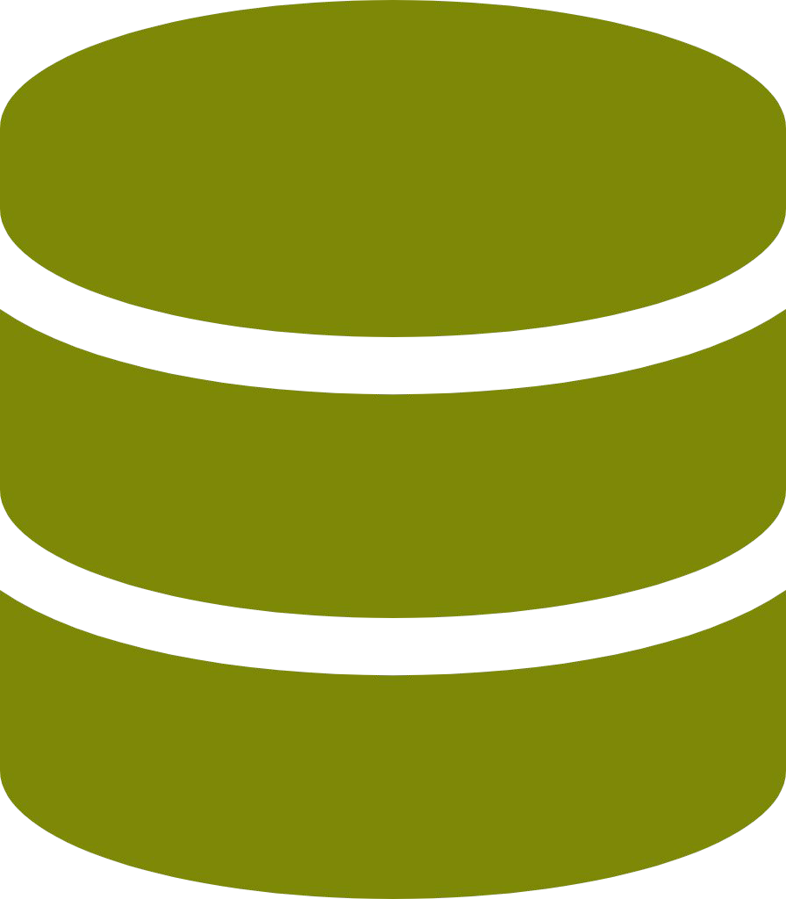

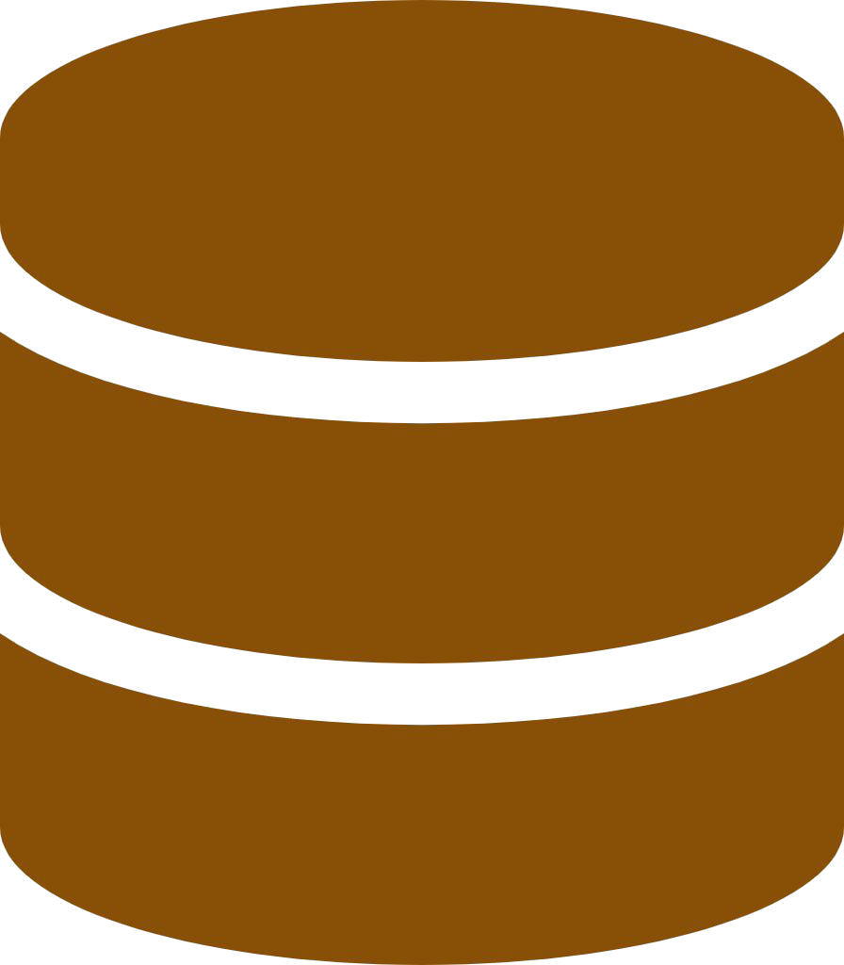

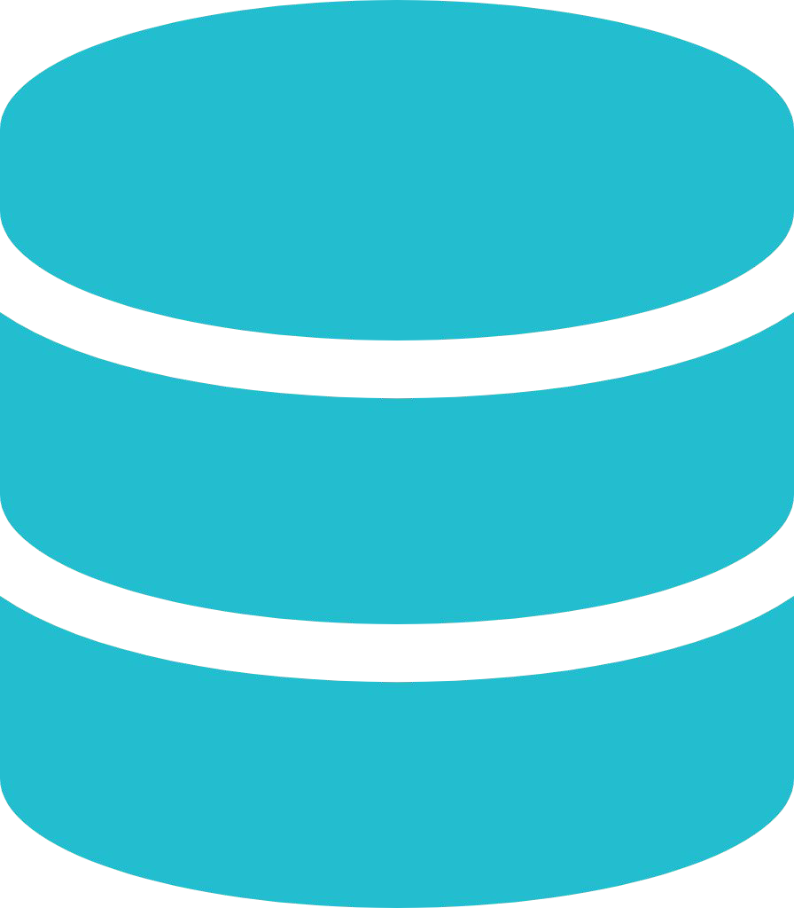

Software Development Workflow (no Docker)
Windows
Node.js Python
Linux
Node.js Python
Mac
Node.js Python
OS Specific installation in every developer machine

Slide 29
Software Development Workflow (no Docker)
Windows
Node.js Python
Linux
Source Control
Node.js Python
GitHub
Every team member moves code to source control
Mac
Node.js Python
OS Specific installation in every developer machine

Slide 30
Software Development Workflow (no Docker)
Windows
Node.js Python
Build Server
Linux
Source Control
Linux
Node.js Python
GitHub
Every team member moves code to source control
Mac
Node.js Python
Build server needs to be installed with all required software/frameworks
Production build is performed by pulling code from source control
OS Specific installation in every developer machine

Slide 31
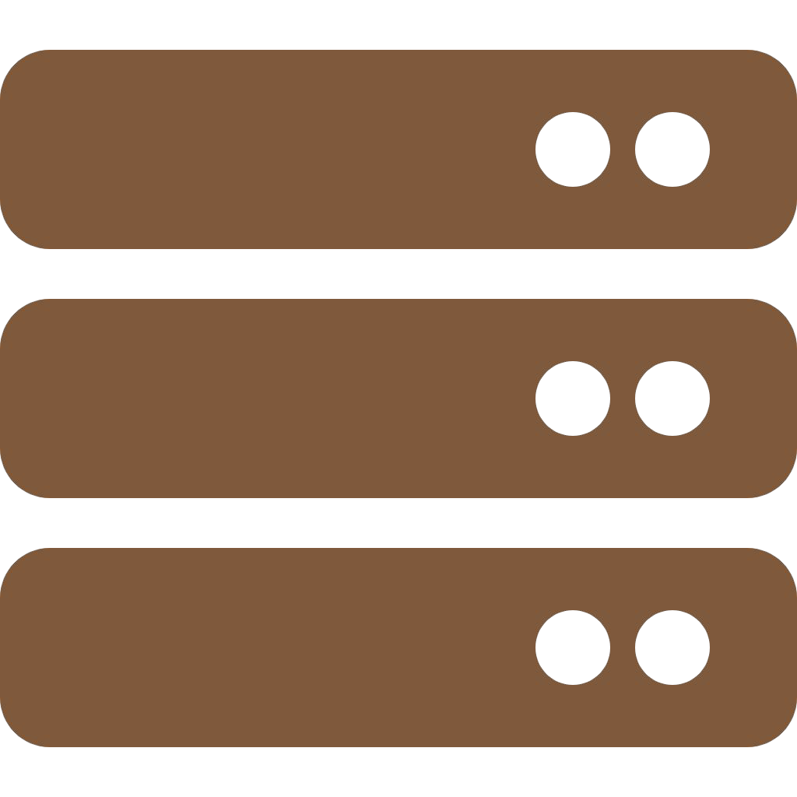
Software Development Workflow (no Docker)
Windows
Node.js Python
Build Server
Production / Test Servers
Linux
Source Control
Linux
Linux Linux
Node.js Python
GitHub
Every team member moves code to source control
Mac
Node.js Python
Build server needs to be installed with all required softwares/frameworks
Production server needs to be installed with all required softwares/frameworks
Production build is performed by pulling code from source control
Production server will be different OS version than development machines
OS Specific installation in every developer machine

Slide 32
Software Development Workflow (with Docker)
Windows
Linux
Mac
Development machines only needs Docker installed
Containers need to be setup only once

Slide 33
Software Development Workflow (with Docker)
Windows
Linux
Source Control
GitHub
Every team member moves code to source control
Mac
Development machines only needs Docker installed
Containers need to be setup only once

Slide 34
Software Development Workflow (with Docker)
Windows
Build Server
Linux
Source Control
Linux
GitHub
Every team member moves code to source control
Mac
Build server only needs
Docker installed
Docker images are built for a release and pushed to container registry
Development machines only needs Docker installed
Containers need to be setup only once

Slide 35
Software Development Workflow (with Docker)
Windows
Build Server
Production/ Test Servers
Linux
Source Control
Linux
Linux Linux
GitHub
Every team member moves code to source control
Mac
Build server only needs
Docker installed
Production server only needs
Docker installed
Docker images are built for a release and pushed to container registry
Production server pulls Docker images from container registry and runs them
Development machines only needs Docker installed
Containers need to be setup only once

